Slide 1
Guess Who?

Slide 2
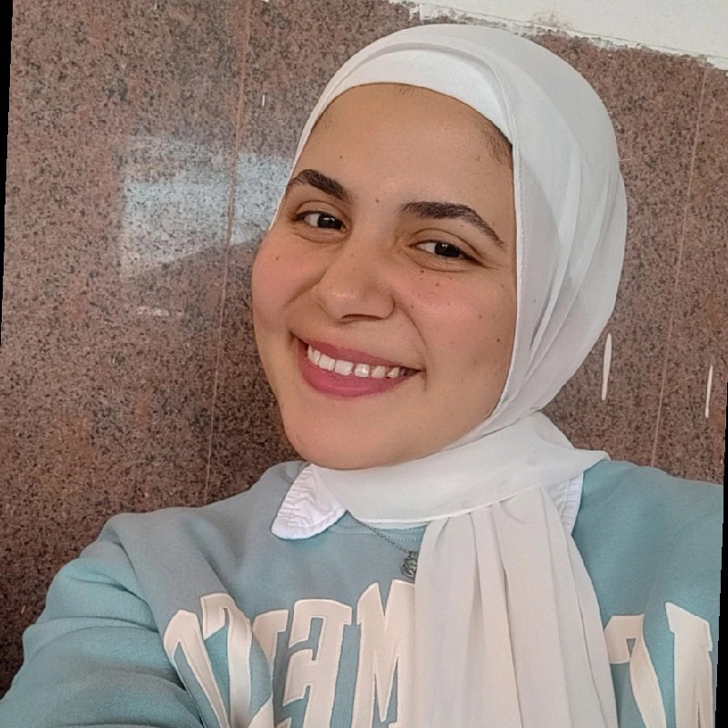
About Fatma
Fatma Alzahraa Sayah Issa
21 years old
FCAI (Faculty of Computers and Artificial Intelligence)
CS (Computer Science)
Level 4
"I challenge myself every day to be stronger, wiser, and better."

Slide 3


My Academic Journey
High School Achievement:
Ranked 4th in my school in the General Secondary Certificate (Thanaweya Amma)
University Performance:
3.55
LEVEL 1 |  |  |  |  | GPA 4
LEVEL 2 |  |  |  |  | GPA 4
LEVEL 3 |  |  |  |  | GPA 4
LEVEL 4 |  |  |  |  | GPA 4
3.51
3.49
3.50

Slide 4
Skills
Some projects HW&SW
C++
Smart Car to solve the Maze
JAVA
Parking Alarm
PYTHON
Fire Alarm
HTML / CSS
Radar
Arduino uno
Calculator

Slide 5






What I Love to Do
Chess
Karate
Darts
Programming
Running
Skate Roller

Slide 6






More Than Just Studies
ICPC
13th UNIVERSITY YOUTH WEEK
Robotics Programming Competition
CREATIVA
Institute for Leadership Development
AI training
SCH Hackathon
Strategy for Using Social Media in Entrepreneurship
CAIRO ICT
Popular and Military Defense Forces
2022
2023
Mohamed Naguib Military Base
Air Force Academy

Slide 7





Proud Achievements
Black Belt in Karate
First Place in Karate in Beheira Governorate
2019
2021
Seventh Place in Karate at the National Level
Second Place in Long Jump at the National Level
2021
2019

Slide 8




Proud Achievements
I participated in a running marathon at the university
First place at the faculty level in chess
4 KM
2023
2024
Second place in darts at the college level
Second place at the university level in the 100-meter race
2023
2021
Secretary of the Social Committee
Second place in stability and balance.
2023
2024

Slide 9
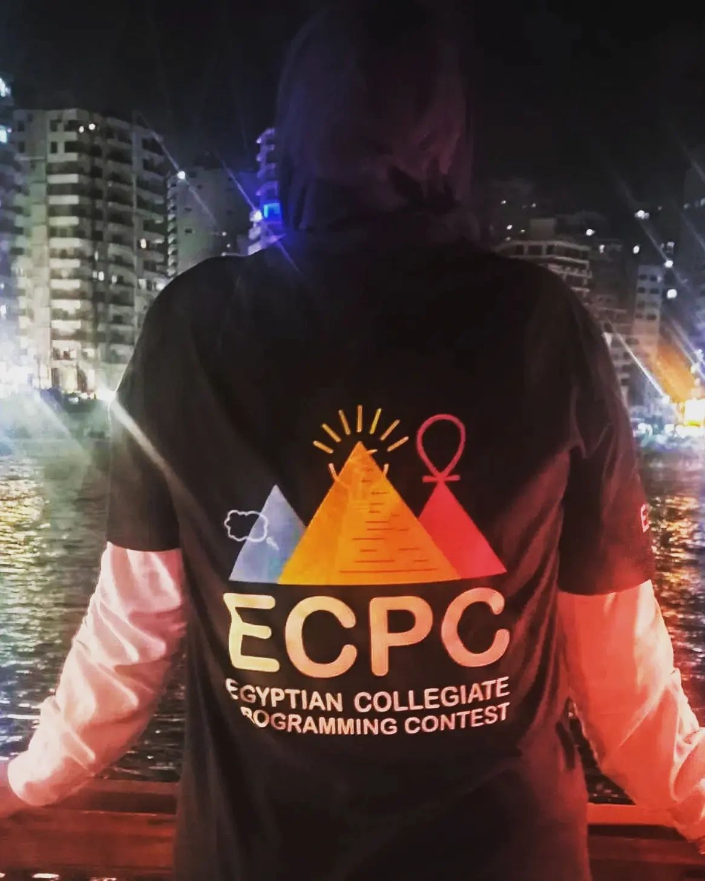
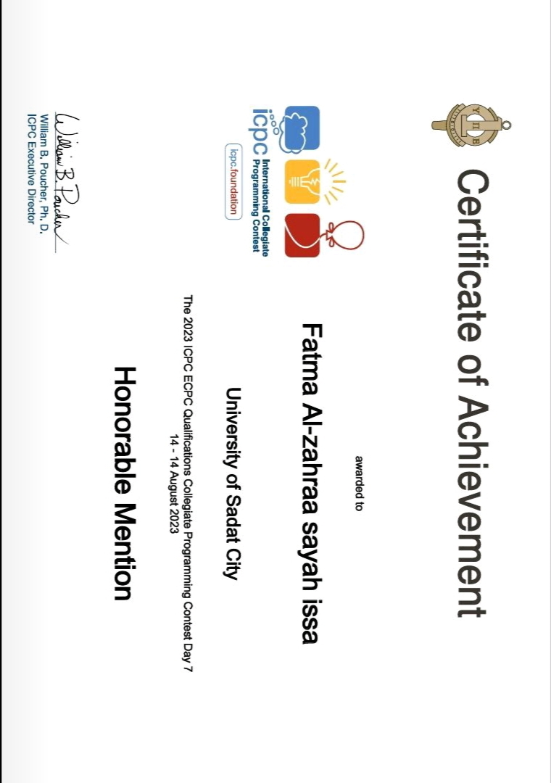
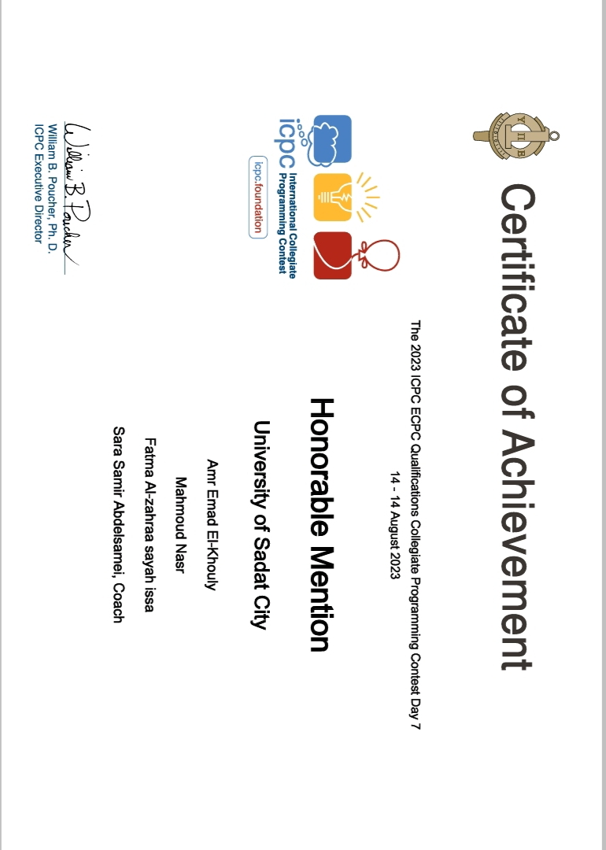
Proof of Dedication

Slide 10
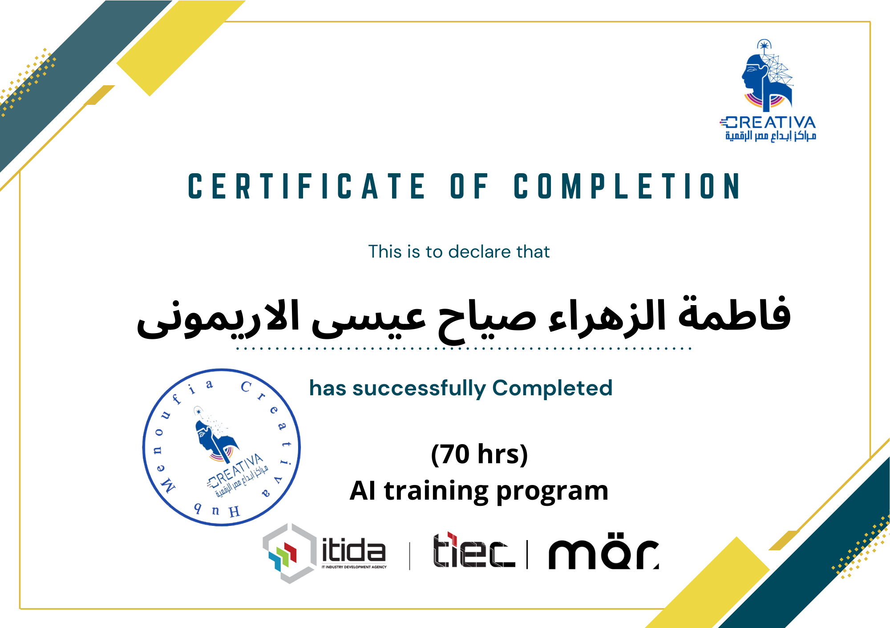
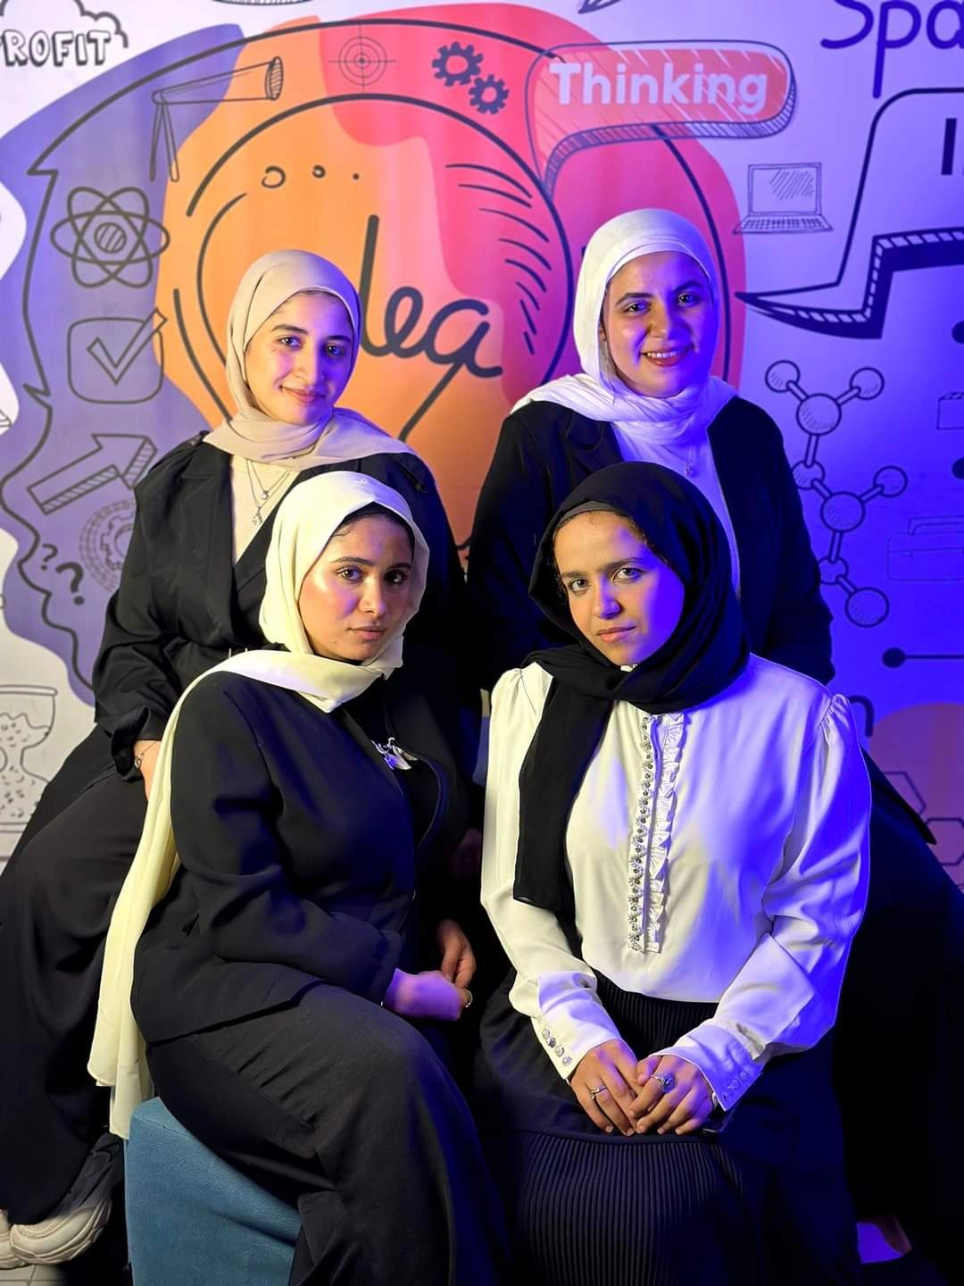
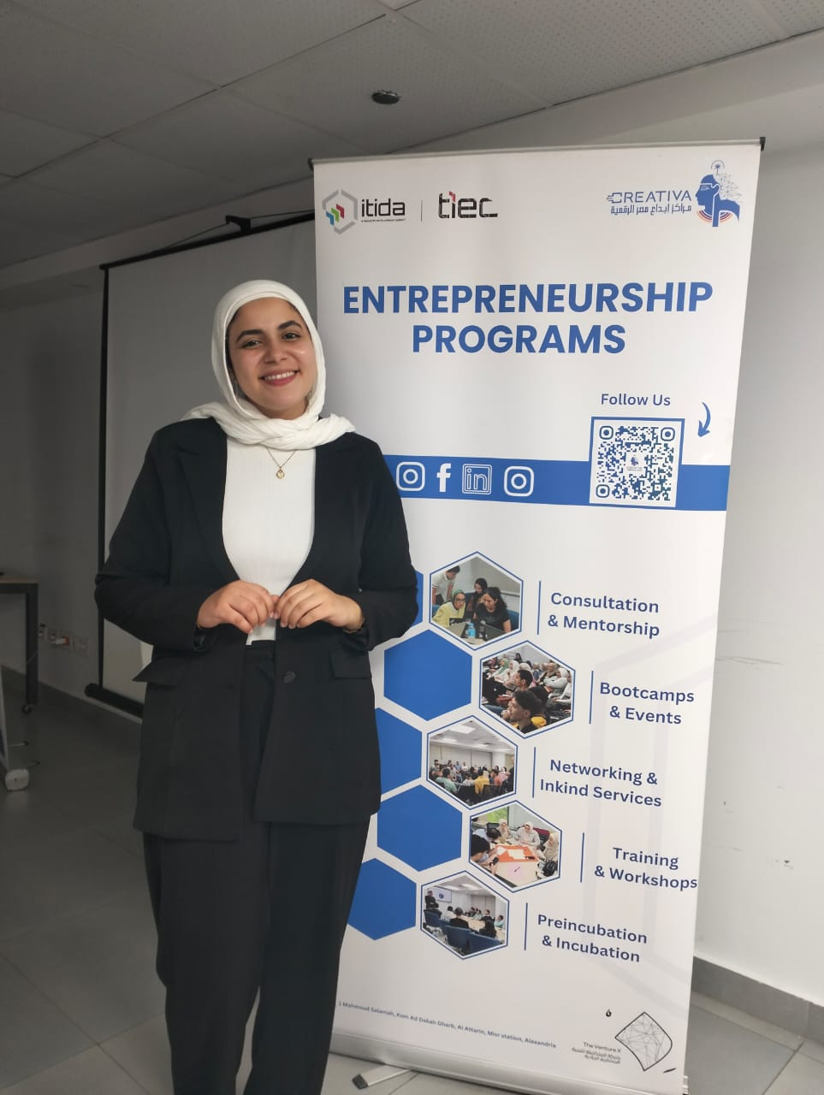
Proof of Dedication

Slide 11
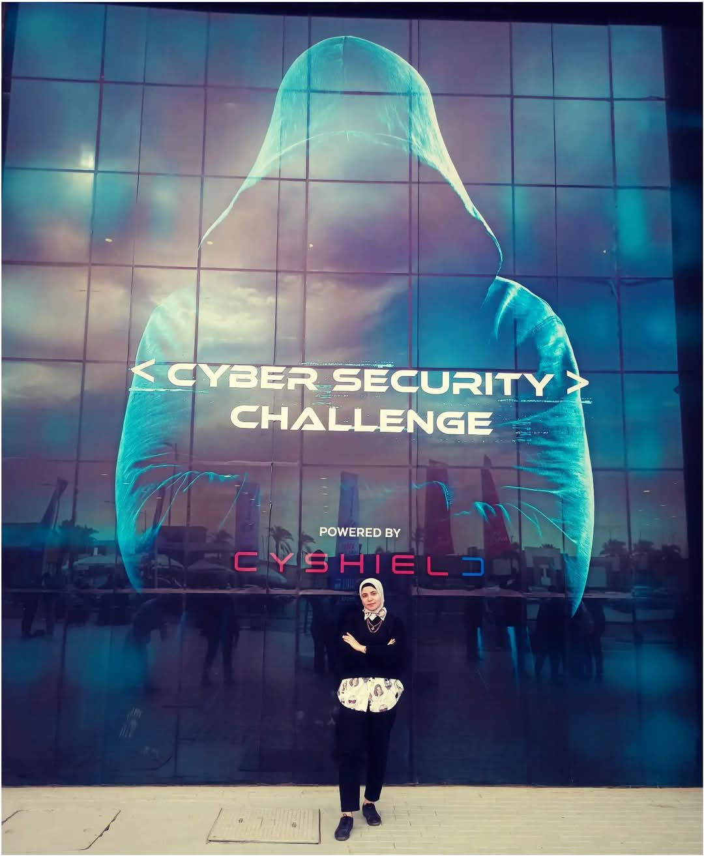
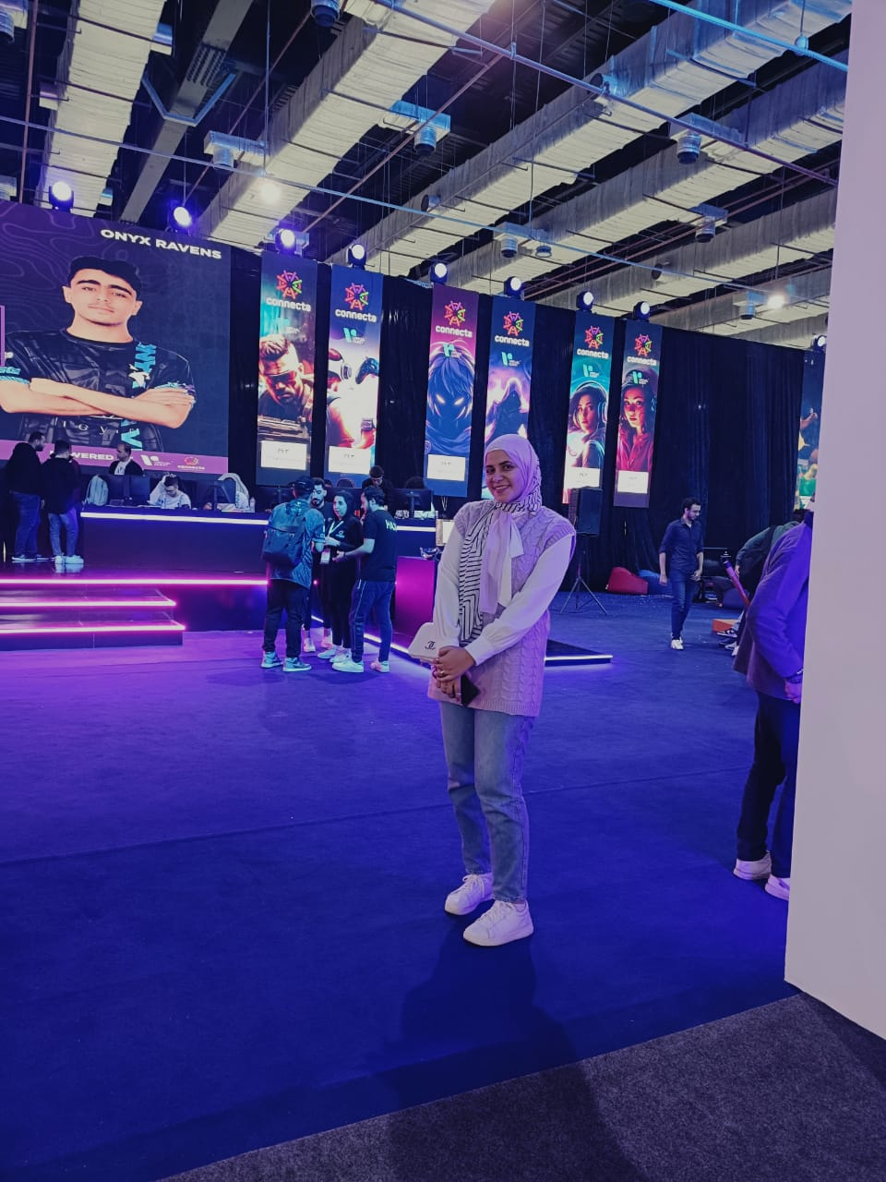
Proof of Dedication

Slide 12
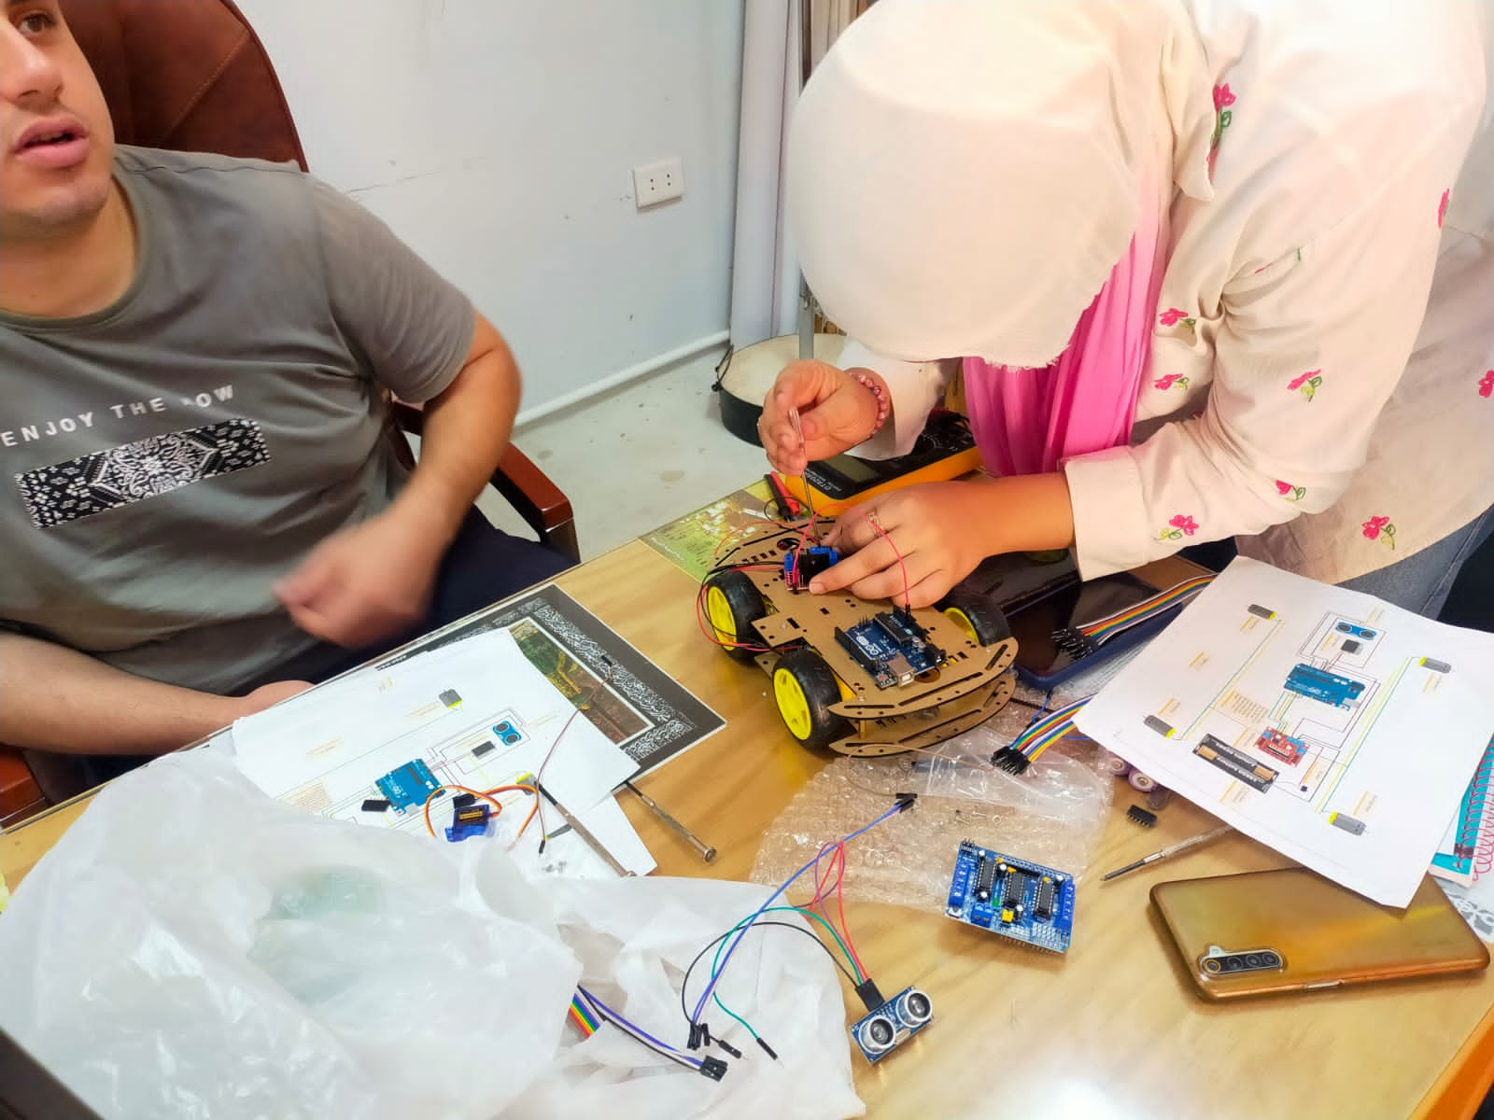
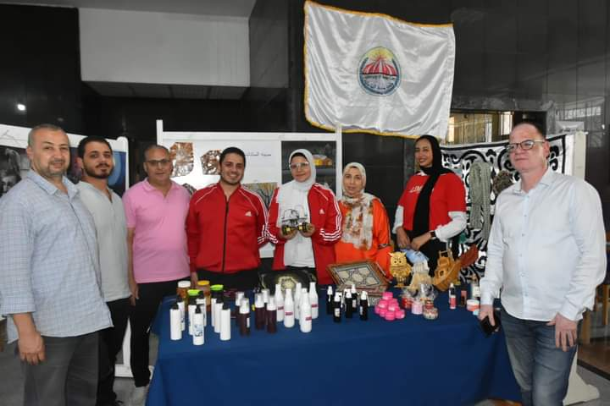
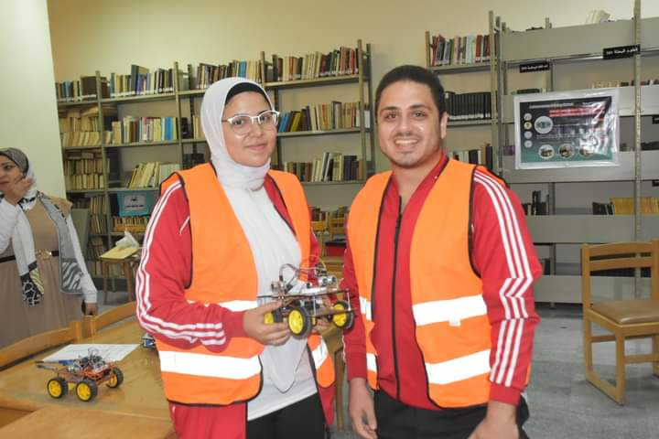
Proof of Dedication

Slide 13
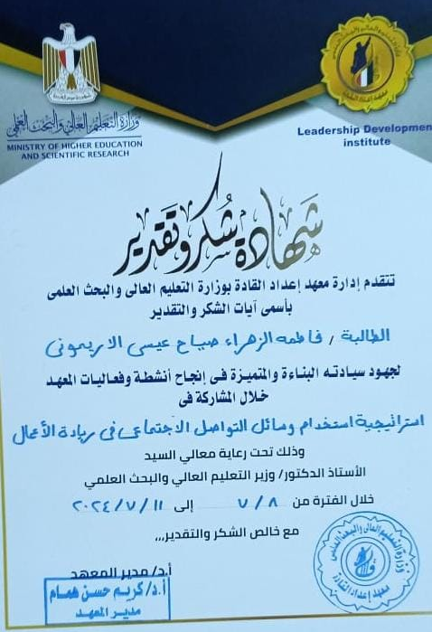
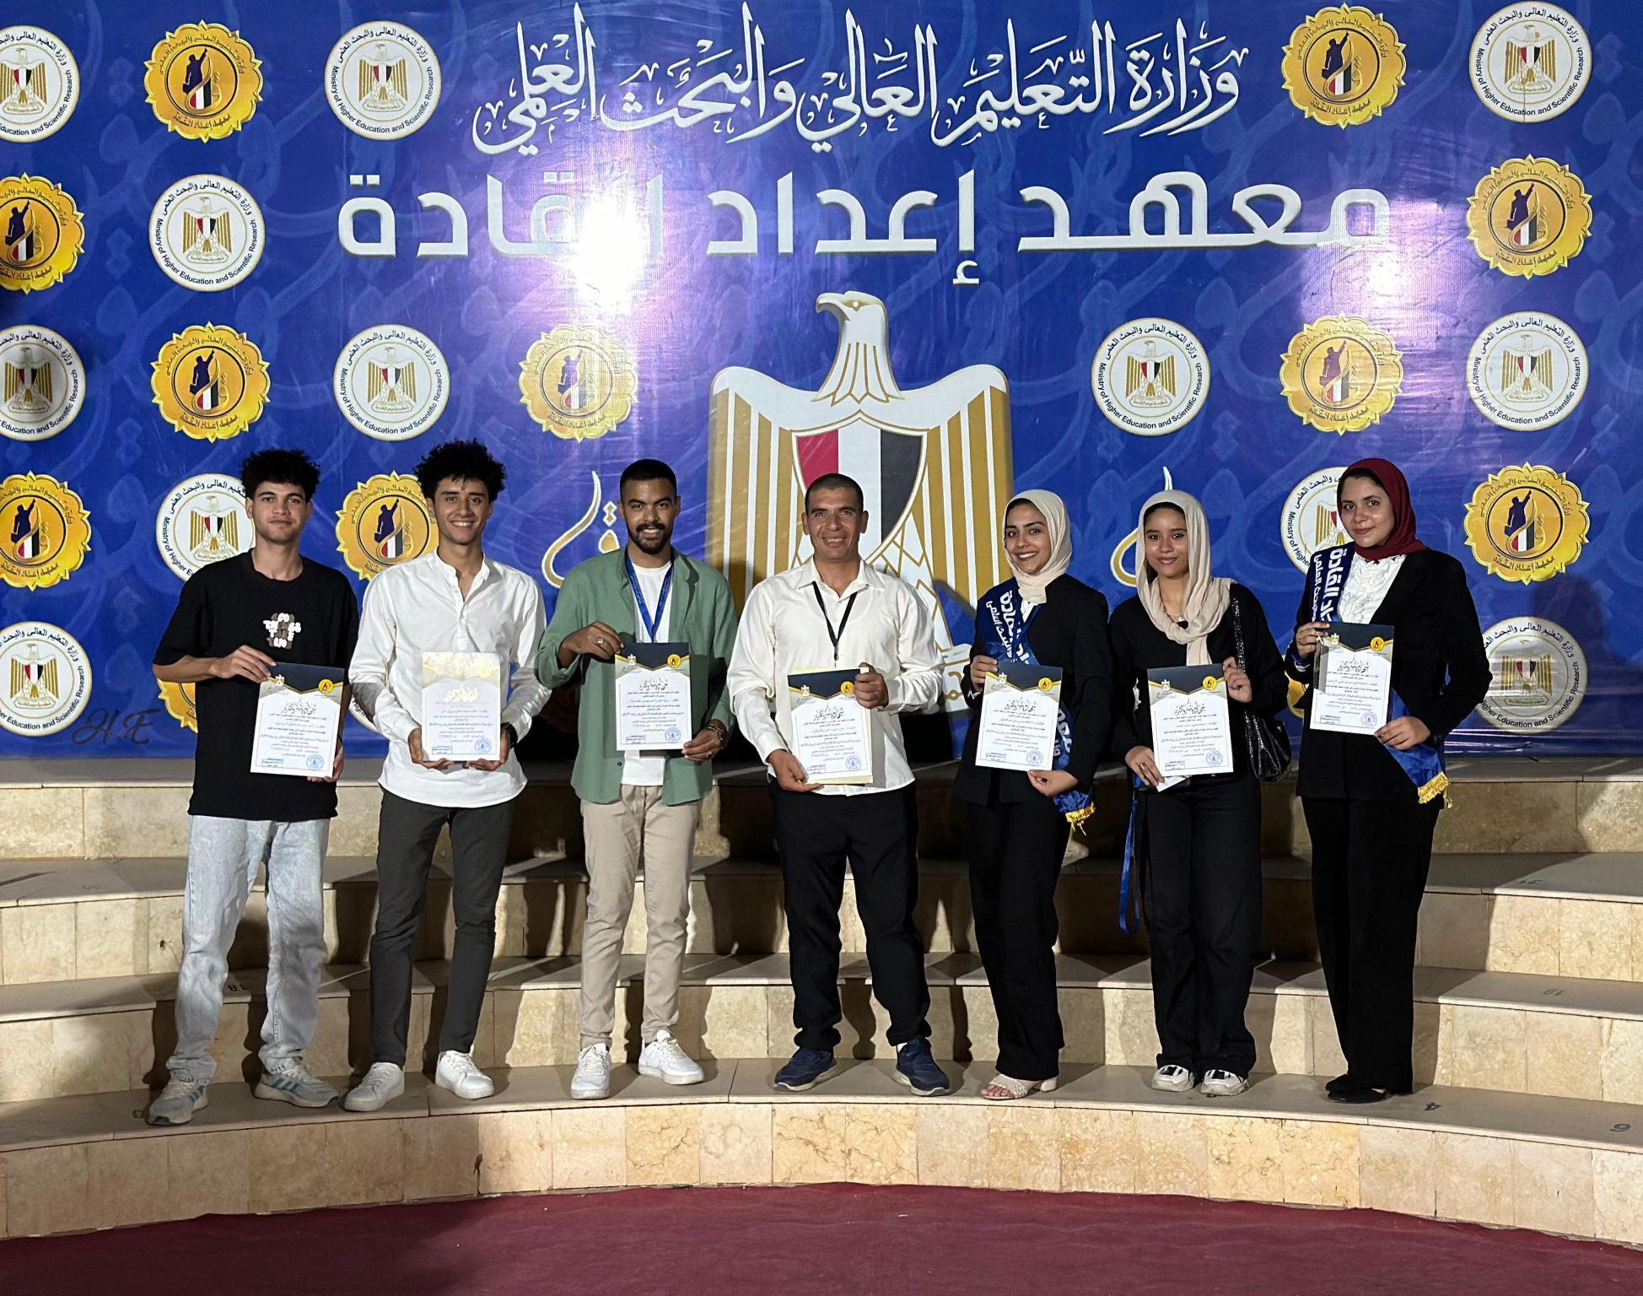
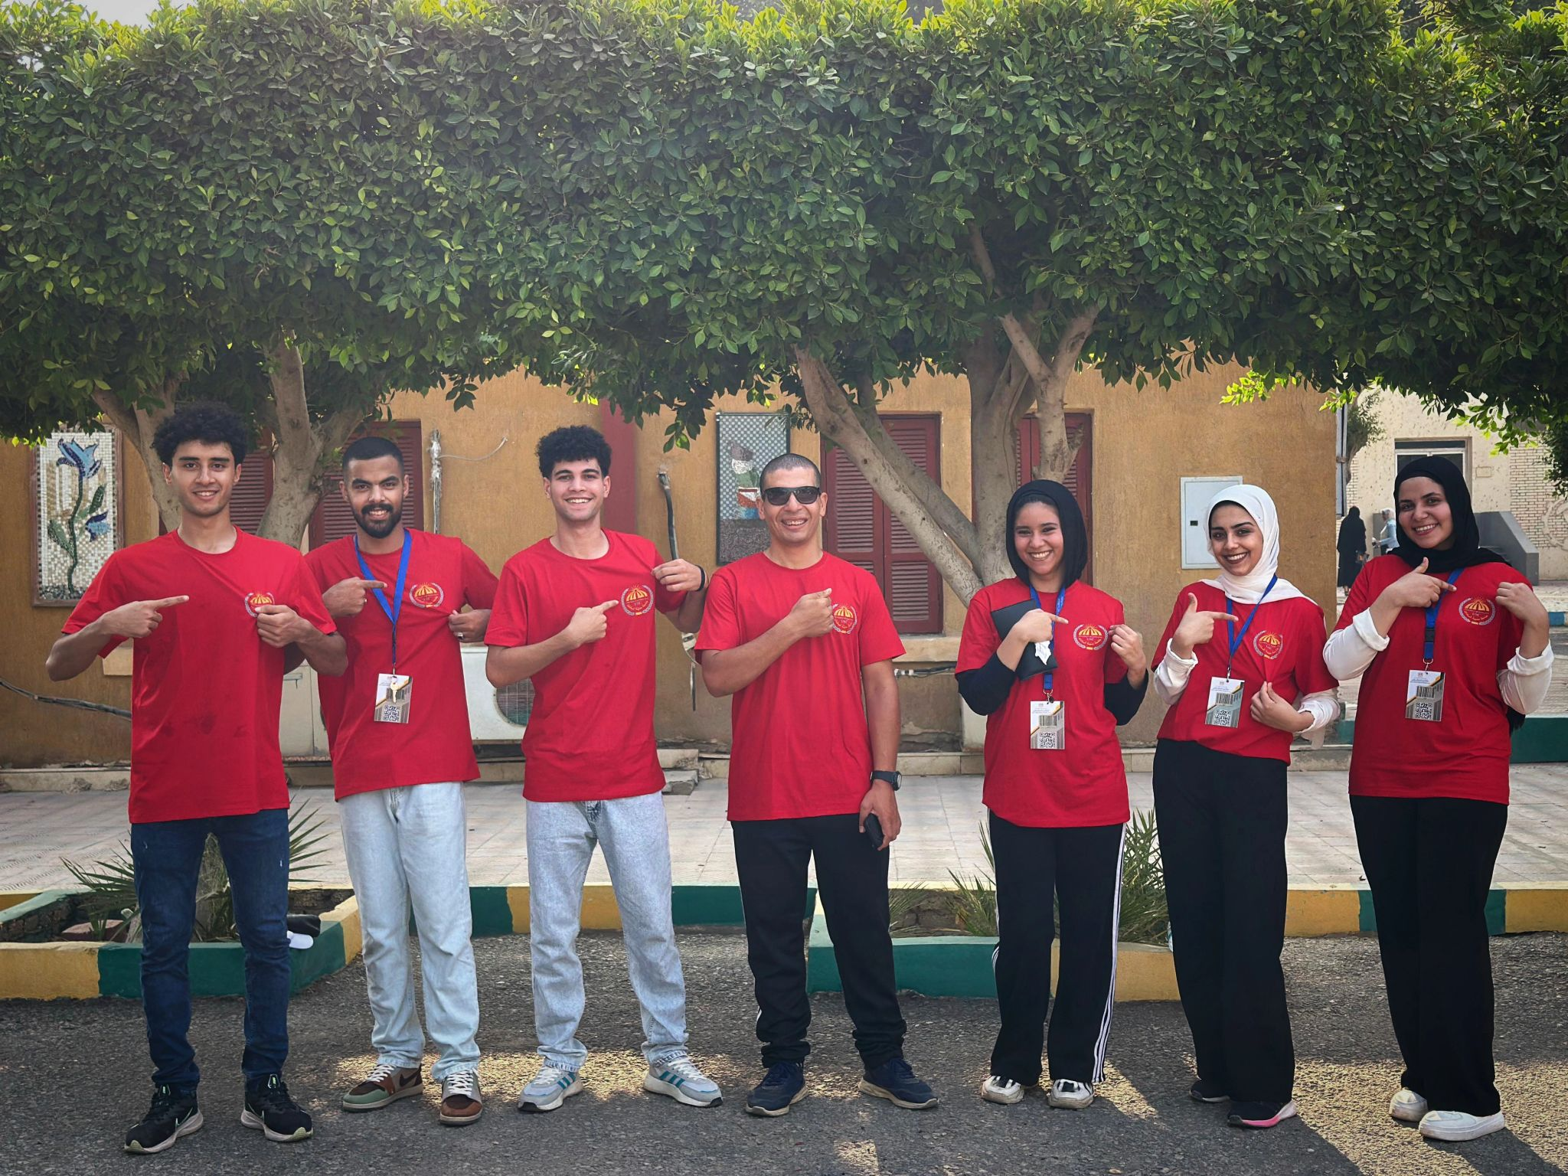
Proof of Dedication

Slide 14
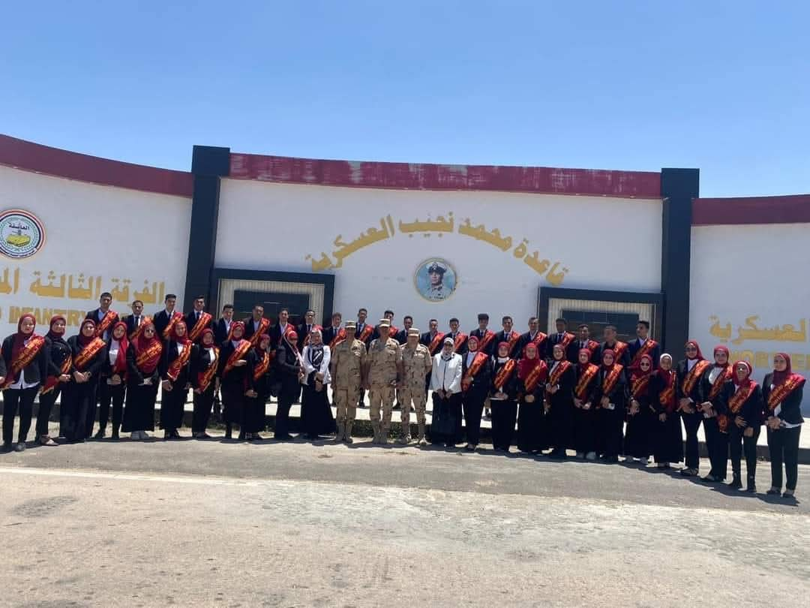
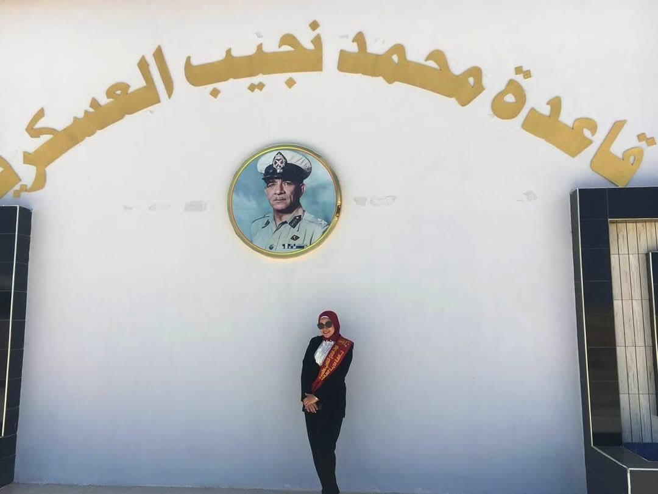
Proof of Dedication

Slide 15

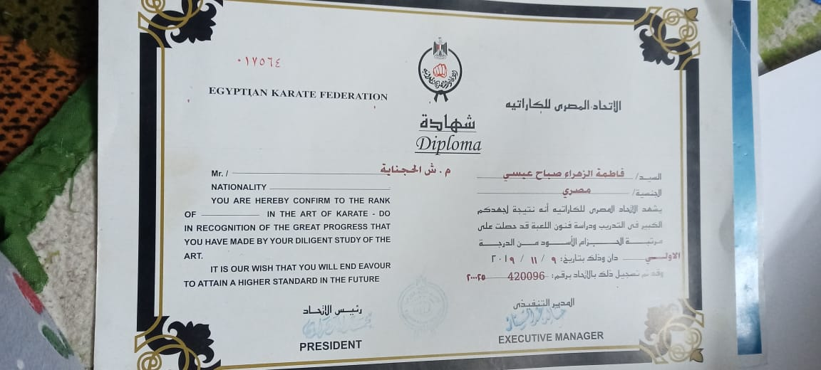
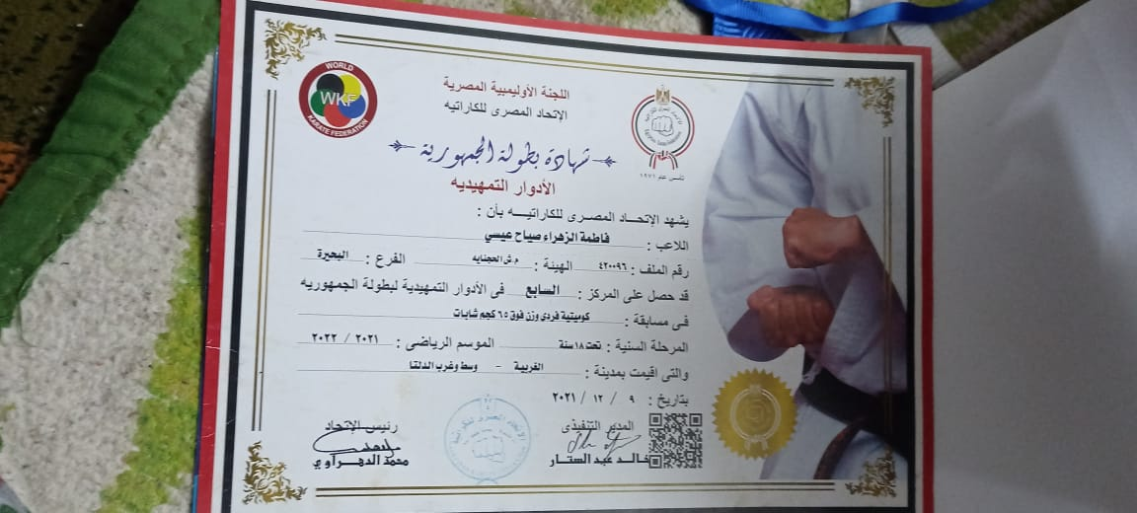
Proof of Dedication

Slide 16
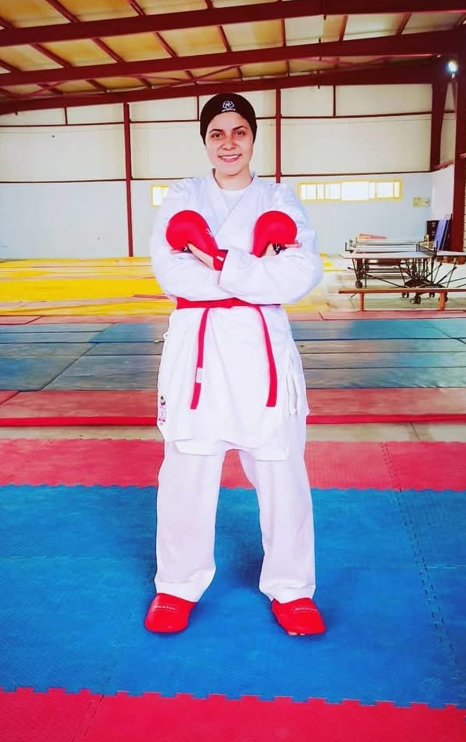
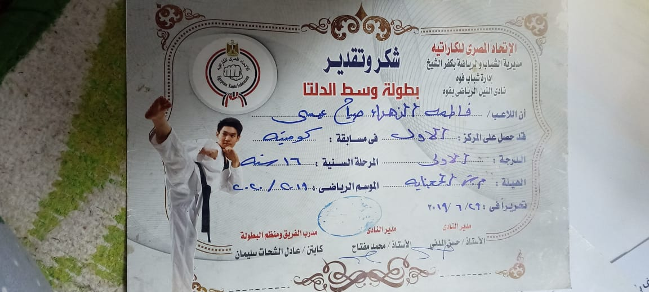
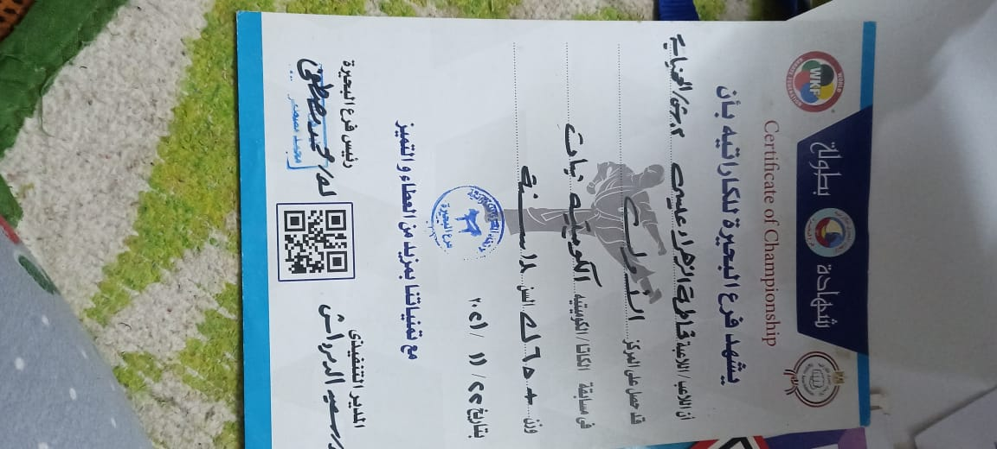
Proof of Dedication

Slide 17

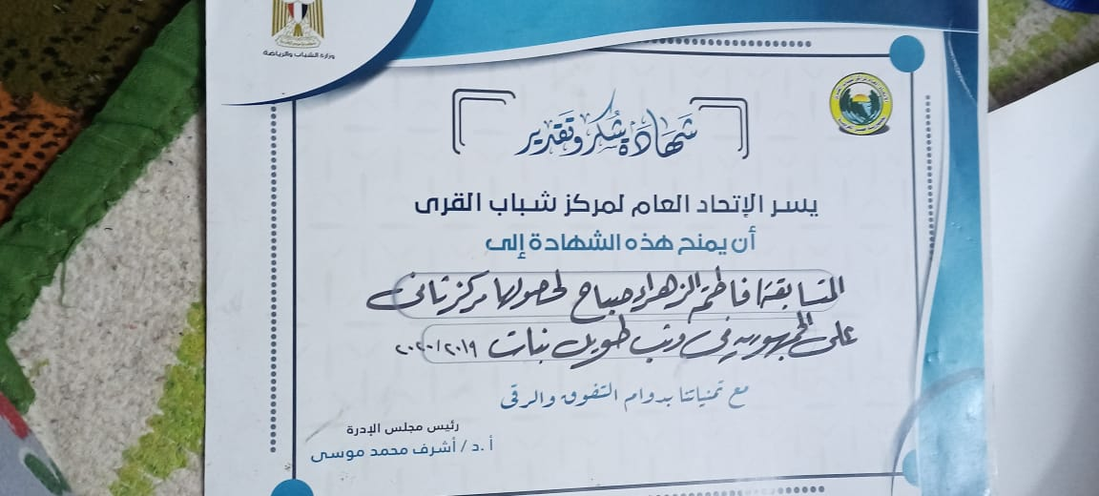
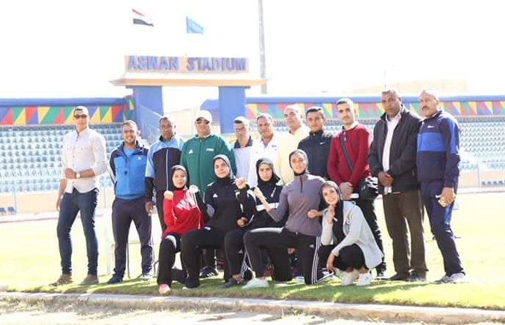
Proof of Dedication

Slide 18


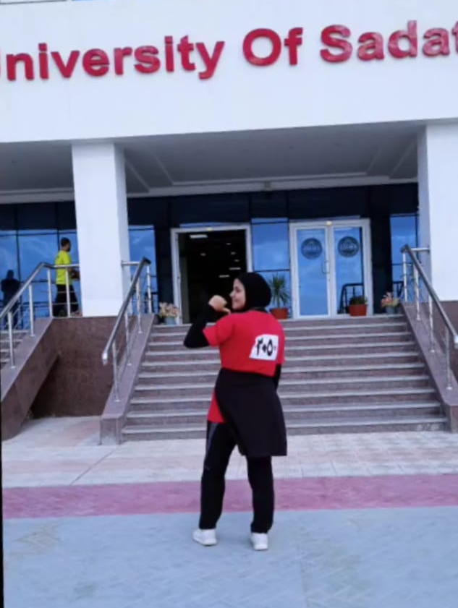
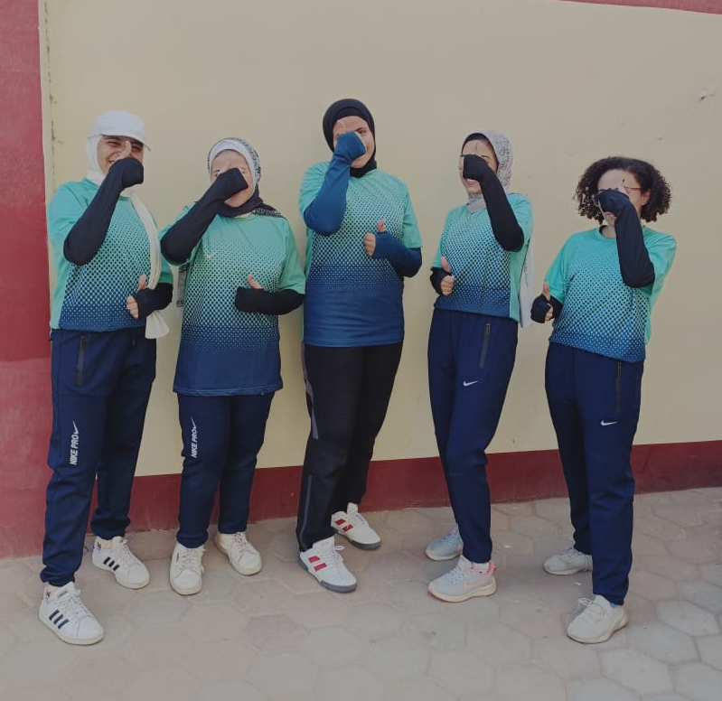
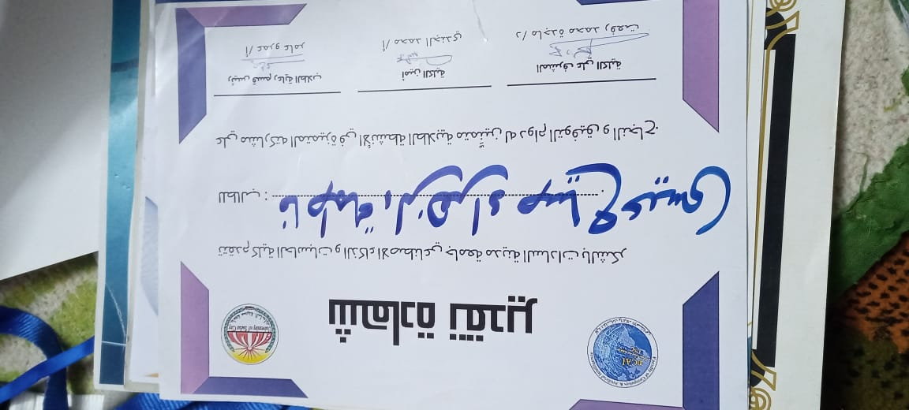
Proof of Dedication

Slide 19
Thanks!

